Slide 1
传统加密技术
Notes:
William Stallings,密码编码学与网络安全-原理与实践

Slide 2
本章要点
密码学基本概念
古典/传统密码体制
  代替/代换技术：凯撒密码、单表代换密码、Playfair密码、Hill密码、多表代替密码；
  置换技术：栅栏技术
转轮密码

Slide 3
基本概念
密码学： 研究如何进行秘密通信或保密通信的科学
密码编码学：对信息进行编码，实现信息保密性
密码分析学：研究、分析、破译密码

Slide 4
密码学的发展历史
第1阶段：1949年以前；
第2阶段：从1949年到1975年；
  标志：1949年Shannon发表《保密系统的信息理论》一文；
第3阶段：1976年至今。
  标志：1976年Diffie和Hellman发表《密码学新方向》一文。

Slide 5
基本术语
明文，plaintext - original message
密文，ciphertext - coded message
密码体制，密码，cipher - algorithm for transforming plaintext to ciphertext
密钥，key - info used in cipher known only to sender/receiver
加密，encipher (encrypt) - converting plaintext to ciphertext
解密，decipher (decrypt) - recovering plaintext from ciphertext
Notes:
Briefly review some terminology used throughout the course.

Slide 6
密码编码学
Cryptography
研究内容
  主要研究对信息进行编码，实现对信息的隐蔽。
特征
  运算类型：代换与置换
  所用的密钥数：单钥与双钥
  处理明文的方法：分组密码与流密码
Notes:
Cryptographic systems can be characterized along these three independent dimensions.

Slide 7
密码算法分类
按照保密内容
  受限制的（restricted）算法：算法的保密性基于保持算法的秘密；
  基于密钥的（key-based）算法：算法的保密性基于对密钥的保密
基于密钥的算法，按照密钥特点
  对称密码算法（传统密码算法或单钥密码算法）
  非对称算法（公开钥密码算法或双钥密码算法）
按照明文处理方式
  分组密码
  流密码

Slide 8
安全要求
加密算法必须足够强
  最低要求：已知密文时不能破译该密文或由密文推导出密钥；
  加强形式：已知某些明、密文对，也不能由此破译出新的密文或发现密钥。
算法是基于密钥的：通信双方必须在某种安全形式下获得密钥并必须保证密钥的安全

Slide 9
密码分析学
Cryptanalysis
密码破译
攻击的一般方法
  密码分析学： cryptanalytic attack
  穷举攻击： brute-force attack
Notes:
Typically objective is to recover the key in use rather then simply to recover the plaintext of a single ciphertext.
There are two general approaches:
Cryptanalytic attacks rely on the nature of the algorithm plus perhaps some knowledge of the general characteristics of the plaintext or even some sample plaintext-ciphertext pairs.
Brute-force attacks try every possible key on a piece of ciphertext until an intelligible translation into plaintext is obtained. On average,half of all possible keys must be tried to achieve success.

Slide 10
基于密码分析的攻击
Cryptanalytic Attacks
惟密文攻击，ciphertext only
  only know algorithm & ciphertext, is statistical, know or can identify plaintext
已知明文攻击，known plaintext
  know/suspect plaintext & ciphertext
选择明文攻击，chosen plaintext
  select plaintext and obtain ciphertext
选择密文攻击，chosen ciphertext
  select ciphertext and obtain plaintext
选择文本攻击，chosen text
  select plaintext or ciphertext to en/decrypt
Notes:
Stallings Table 2.1 summarizes the various types of cryptanalytic attacks, based on the amount of information known to the cryptanalyst, from least to most. The most difficult problem is presented when all that is available is the ciphertext only. In some cases, not even the encryption algorithm is known, but in general we can assume that the opponent does know the algorithm used for encryption. Then with increasing information have the other attacks. Generally, an encryption algorithm is designed to withstand a known-plaintext attack.

Slide 11
两个概念
绝对安全，Unconditional Security
计算安全，Computational Security
19世纪，Kerckhoff原则：
系统的保密性不依赖于对加密体制或算法的保密，而依赖于对密钥的保密。
Notes:
Two more definitions are worthy of note. An encryption scheme is unconditionally secure if the ciphertext generated by the scheme does not contain enough information to determine uniquely the corresponding plaintext, no matter how much ciphertext is available. An encryption scheme is said to be computationally secure if either the cost of breaking the cipher exceeds the value of the encrypted information, or the time required to break the cipher exceeds the useful lifetime of the information. Unconditional security would be nice, but the only known such cipher is the one-time pad (later).
For all reasonable encryption algorithms, we have to assume computational security where it either takes too long, or is too expensive, to bother breaking the cipher.

Slide 12
穷举攻击
Key Size (bits) | Number of Alternative Keys | Time required at 1 decryption/µs | Time required at 10⁶ decryptions/µs
32 | 2³² = 4.3 × 10⁹ | 2³¹ µs = 35.8 minutes | 2.15 milliseconds
56 | 2⁵⁶ = 7.2 × 10¹⁶ | 2⁵⁵ µs = 1142 years | 10.01 hours
128 | 2¹²⁸ = 3.4 × 10³⁸ | 2¹²⁷ µs = 5.4 × 10²⁴ years | 5.4 × 10¹⁸ years
168 | 2¹⁶⁸ = 3.7 × 10⁵⁰ | 2¹⁶⁷ µs = 5.9 × 10³⁶ years | 5.9 × 10³⁰ years
26 characters (permutation) | 26! = 4 × 10²⁶ | 2 × 10²⁶ µs = 6.4 × 10¹² years | 6.4 × 10⁶ years
Notes:
A brute-force attack involves trying every possible key until an intelligible translation of the ciphertext into plaintext is obtained. On average, half of all possible keys must be tried to achieve success. Stallings Table 2.2 shows how much time is required to conduct a brute-force attack, for various common key sizes (DES is 56, AES is 128, Triple-DES is 168, plus general mono-alphabetic cipher), where either a single system or a million parallel systems, are used.

Slide 13
非技术因素的攻击
偷窃
收买
逼问
…

Slide 14
§2.1 对称密码的模型
传统密码/常规密码/私钥密码/单钥密码conventional / private-key / single-key
发送方和接收方共享一个共同的密钥
sender and recipient share a common key
所有的传统密码算法都是私钥密码
20世纪70年代以前私钥密码是唯一类型
至今仍广泛应用
Notes:
Symmetric encryption, also referred to as conventional encryption or single-key encryption, was the only type of encryption in use prior to the development of public-key encryption in the 1970s. It remains by far the most widely used of the two types of encryption. All traditional schemes are symmetric / single key / private-key encryption algorithms, with a single key, used for both encryption and decryption. Since both sender and receiver are equivalent, either can encrypt or decrypt messages using that common key.

Slide 15
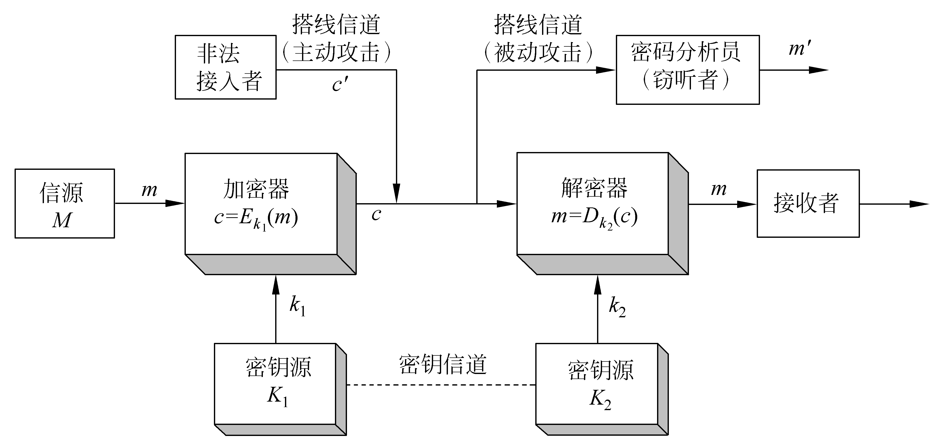
对称密码模型
（Symmetric Cipher Model）
Notes:
Detail the five ingredients of the symmetric cipher model, shown in Stallings Figure 2.1:
plaintext - original message
encryption algorithm – performs substitutions/transformations on plaintext
secret key – control exact substitutions/transformations used in encryption algorithm
ciphertext - scrambled message
decryption algorithm – inverse of encryption algorithm

Slide 16
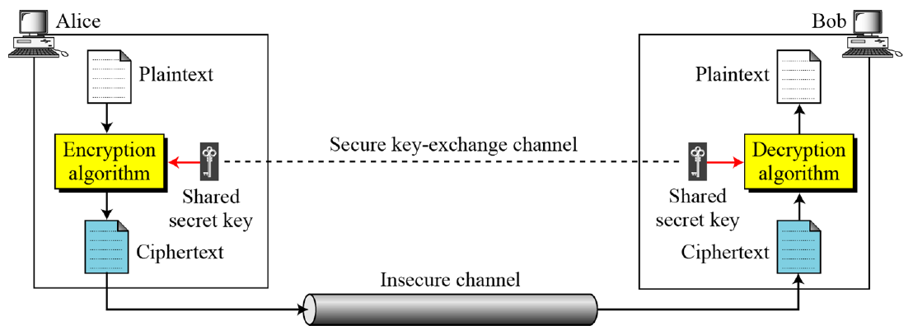
对称密码模型
（Symmetric Cipher Model）
Notes:
Detail the five ingredients of the symmetric cipher model, shown in Stallings Figure 2.1:
plaintext - original message
encryption algorithm – performs substitutions/transformations on plaintext
secret key – control exact substitutions/transformations used in encryption algorithm
ciphertext - scrambled message
decryption algorithm – inverse of encryption algorithm

Slide 17

对称密码模型
（Symmetric Cipher Model）
Notes:
Detail the five ingredients of the symmetric cipher model, shown in Stallings Figure 2.1:
plaintext - original message
encryption algorithm – performs substitutions/transformations on plaintext
secret key – control exact substitutions/transformations used in encryption algorithm
ciphertext - scrambled message
decryption algorithm – inverse of encryption algorithm

Slide 18
对称密码安全的两个必备条件:
  加密算法必须是足够强的
  a strong encryption algorithm
  惟有发送者和接收者知道的秘密密钥
  a secret key known only to sender / receiver
数学表示:
  C = E_{K}(P)
  P = D_{K}(C)
假设加/解密算法是已知的
拥有一个安全通道用于分发密钥
Notes:
We assume that it is impractical to decrypt a message on the basis of the cipher- text plus knowledge of the encryption/decryption algorithm, and do not need to keep the algorithm secret; rather we only need to keep the key secret. This feature of symmetric encryption is what makes it feasible for widespread use. It allows easy distribution of s/w and h/w implementations.
Can take a closer look at the essential elements of a symmetric encryption scheme: mathematically it can be considered a pair of functions with: plaintext X, ciphertext Y, key K, encryption algorithm E_{K}, decryption algorithm D_{K}.

Slide 19
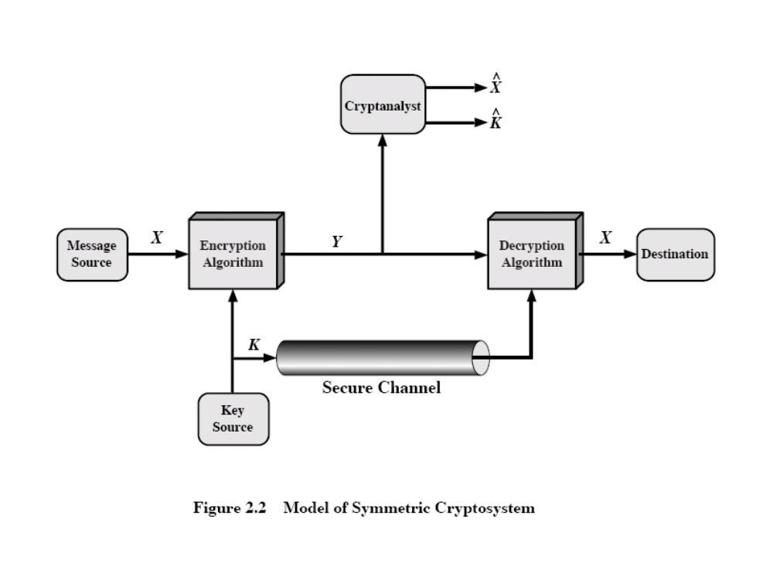

Slide 20
§2.2 古典代替密码
将明文字母替换成其他字母、数字或符号的方法;
如果把明文看成是0或1的序列，那么密文就是0或1比特序列的另一种表达。
Notes:
In this section and the next, we examine a sampling of what might be called classical encryption techniques. A study of these techniques enables us to illustrate the basic approaches to symmetric encryption used today and the types of cryptanalytic attacks that must be anticipated. The two basic building blocks of all encryption technique are substitution and transposition. We examine these in the next two sections. Finally, we discuss a system that combine both substitution and transposition.

Slide 21
§2.2.1 恺撒密码 Caesar Cipher
所知道的最早的代替密码
Julius Caesar
首先用在军事通信中
用字母后的第三个字母代替
明 文 | a | b | c | d | e | f | g | h | i | j | k | l | m | n | o | p | q | r | s | t | u | v | w | x | y | z
密 文 | D | E | F | G | H | I | J | K | L | M | N | O | P | Q | R | S | T | U | V | W | X | Y | Z | A | B | C
Notes:
Substitution ciphers form the first of the fundamental building blocks. The core idea is to replace one basic unit (letter/byte) with another. Whilst the early Greeks described several substitution ciphers, the first attested use in military affairs of one was by Julius Caesar, described by him in Gallic Wars (cf. Kahn pp83-84). Still call any cipher using a simple letter shift a caesar cipher, not just those with shift 3.

Slide 22
恺撒密码 - 加密
方式一：公式计算
  明文编码：
  如a=0，b=1，…，z=25，则
  明文P ＝ p₁p₂…p_{n}
  （加密）运算：C_{i} ＝ p_{i} + k （mod 26）, i ＝ 1,2,…,n
  解码得密文：C ＝ c_{1c}c₂…c_{n}

Slide 23
恺撒密码-加密
方式二：查表（例k=3）
明 文 | a | b | c | d | e | f | g | h | i | j | k | l | m | n | o | p | q | r | s | t | u | v | w | x | y | z
密 文 | D | E | F | G | H | I | J | K | L | M | N | O | P | Q | R | S | T | U | V | W | X | Y | Z | A | B | C

Slide 24
恺撒密码 - 解密
方式一：公式计算
  密文C ＝ c₁c₂…c_{n}
  （加密）运算：P_{i} ＝ c_{i} - k （mod 26）, i＝1,2,…,n
  解码得明文： P ＝ p₁p₂…p_{n}

Slide 25
恺撒密码-解密
方式二：查表（例k=3）
密文 | A | B | C | D | E | F | G | H | I | J | K | L | M | N | O | P | Q | R | S | T | U | V | W | X | Y | Z
明文 | x | y | z | a | b | c | d | e | f | g | h | i | j | k | l | m | n | o | p | q | r | s | t | u | v | w

Slide 26
恺撒密码
  c = E(p) = (p + k) mod (26)
  p = D(c) = (c – k) mod (26)
Notes:
This mathematical description uses modulo (clock) arithmetic. Here, when you reach Z you go back to A and start again. Mod 26 implies that when you reach 26, you use 0 instead (ie the letter after Z, or 25 + 1 goes to A or 0).
Example: howdy (7,14,22,3,24) encrypted using key f (ie a shift of 5) is MTBID

Slide 27
恺撒密码的密码分析
共有密钥25个
可简单地依次去测试 、强力搜索、穷举攻击
基于字母频率的破译方法
所破译的明文需要识别
  如：破译密文 "GCUA VQ DTGCM“
  → dzrx sn aqdzj （k=3）
  → easy to break （k=2）
Notes:
With a caesar cipher, there are only 26 possible keys, of which only 25 are of any use, since mapping A to A etc doesn't really obscure the message! Note this basic rule of cryptanalysis "check to ensure the cipher operator hasn't goofed and sent a plaintext message by mistake"!
Can try each of the keys (shifts) in turn, until can recognise the original message. See Stallings Fig 2.3 for example of search.
Note: as mentioned before, do need to be able to recognise when have an original message (ie is it English or whatever). Usually easy for humans, hard for computers. Though if using say compressed data could be much harder.
Example "GCUA VQ DTGCM" when broken gives "easy to break", with a shift of 2 (key C).

Slide 28
§2.2.2 单表代替密码
密钥短语密码就是选一个英文短语作为密钥字(Key Word)或密钥短语(Key Phrase)，如HAPPY NEW YEAR，去掉重复字母得HAPYNEWR。
将它依次写在明文字母表之下，而后再将字母表中未在短语中出现过的字母依次写于此短语之后，就可构造出一个字母代换表。

Slide 29

若明文为：
  P = Casear cipher is a shift substitution
则密文为：
  C=PHONHM PBKRNM BO H ORBEQ OSAOQBQSQBJI

Slide 30
单表代替密码分析
不是简单有序地字母移位
任意地打乱字母的顺序
每个明文字母映射到一个不同的随机密文字母
密钥数目： 26！
Notes:
With only 25 possible keys, the Caesar cipher is far from secure. A dramatic increase in the key space can be achieved by allowing an arbitrary substitution, where the translation alphabet can be any permutation of the 26 alphabetic characters.
See example translation alphabet, and an encrypted message using it.

Slide 31
单表代替密码分析
密钥空间： 26! ＞ 4 x 10²⁶
貌似安全，实则不然
语言特性
Notes:
Note that even given the very large number of keys, being 10 orders of magnitude greater than the key space for DES, the monoalphabetic substitution cipher is not secure, because it does not sufficiently obscure the underlying language characteristics.

Slide 32
语言的冗余与密码分析
人类的语言是有冗余的
字母的使用频率是不同的
在英语中E使用的频率最高
有些字母使用较少
单字母、双字母、三字母组合统计
Notes:
As the example shows, we don't actually need all the letters in order to understand written English text. Here vowels were removed, but they're not the only redundancy. cf written Hebrew has no vowels for same reason. Are usually familiar with "party conversations", can hear one person speaking out of hubbub of many, again because of redundancy in aural language also. This redundancy is also the reason we can compress text files, the computer can derive a more compact encoding without losing any information. Basic idea is to count the relative frequencies of letters, and note the resulting pattern.

Slide 33

英语字母使用频率
Notes:
Note that all human languages have varying letter frequencies, though the number of letters and their frequencies varies. Stallings Figure 2.5 shows English letter frequencies. Seberry & Pieprzyk, "Cryptography - An Introduction to Computer Security", Prentice-Hall 1989, Appendix A has letter frequency graphs for 20 languages (most European & Japanese & Malay).

Slide 34
§2.2.1 Playfair密码
单表代替密码由于密钥空间较小所以无法提供安全性；
Playfair密码是一个多表代替密码 ；
Charles Wheatstone 于1854年发明, 用其朋友Baron Playfair 命名。
Notes:
Consider ways to reduce the "spikyness" of natural language text, since if just map one letter always to another, the frequency distribution is just shuffled. One approach is to encrypt more than one letter at once. The Playfair cipher is an example of doing this.

Slide 35
Playfair密钥矩阵
5 X 5
填写密钥单词
用其他字母填写剩下的空缺
I = J
M | O | N | A | R
C | H | Y | B | D
E | F | G | I/J | K
L | P | Q | S | T
U | V | W | X | Z
Notes:
The best-known multiple-letter encryption cipher is the Playfair, which treats digrams in the plaintext as single units and translates these units into ciphertext digrams. The Playfair algorithm is based on the use of a 5x5 matrix of letters constructed using a keyword. The rules for filling in this 5x5 matrix are: L to R, top to bottom, first with keyword after duplicate letters have been removed, and then with the remain letters, with I/J used as a single letter. This example comes from Dorothy Sayer's book "Have His Carcase", in which Lord Peter Wimsey solves it, and describes the use of a probably word attack.

Slide 36
Playfair密码的加/解密步骤
加密
  明文分组（填充）：2个字母／组
  同行字母对加密：循环向右，ei→FK
  同列字母对加密：循环向下，cu→EM，xi→AS
  其它字母对加密：矩形对角线字母，且按行排序，ya→BN，es→IL（或JL）
解密
  加密的逆向操作

Slide 37
Playfair密码安全性分析
安全性优于单表代替密码
密钥空间：＝25！≈1.6×10²⁵
在WW1（一战）中使用多年
虽然明文中字母的统计规律在密文中得到了降低，但密文中仍含有明文的部分结构信息
给定几百个字母，即可被攻破
明、密文字母不是一一对应关系
Notes:
The Playfair cipher is a great advance over simple monoalphabetic ciphers, since there are 26*26=676 digrams (vs 26 letters), so that identification of individual digrams is more difficult. Also,the relative frequencies of individual letters exhibit a much greater range than that of digrams, making frequency analysis much more difficult. The Playfair cipher was for a long time considered unbreakable. It was used as the standard field system by the British Army in World War I and still enjoyed considerable use by the U.S.Army and other Allied forces during World War II. Despite this level of confidence in its security,the Playfair cipher is relatively easy to break because it still leaves much of the structure of the plaintext language intact

Slide 38
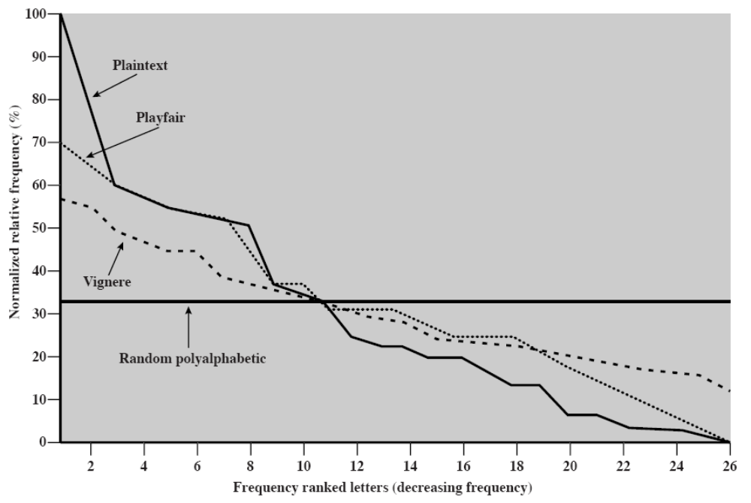
字母出现的相对频率

Slide 39
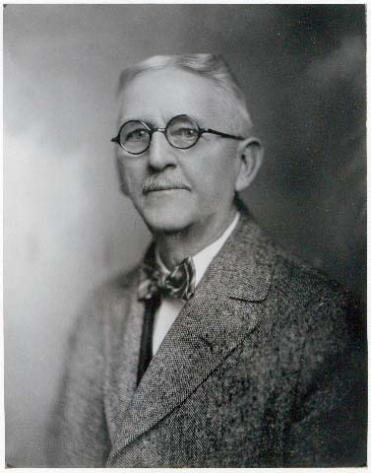
§2.2.4 希尔(Hill)密码
莱斯特·S·希尔（Lester S. Hill，1891–1961），美国数学家、教育家。1911年于哥伦比亚大学读完学士学位，1926年在耶鲁大学读完博士学位，于1929年发明希尔密码。
是多表代替密码
利用模运算意义下的矩阵乘法、求逆矩阵、线性无关、线性空间与线性变换等概念和运算

Slide 40
Hill密码的加/解密过程
加密:
明文分组并编码
C≡KP mod 26，其中，K为密钥矩阵，P、C分别为明、密文分组
解密:
密文分组并编码
P≡K⁻¹C mod 26
对密钥矩阵K的要求：在mod 26下可逆

Slide 41
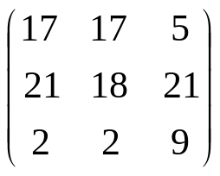
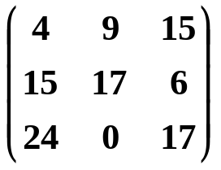
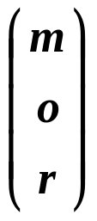
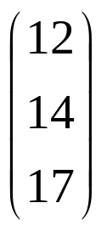
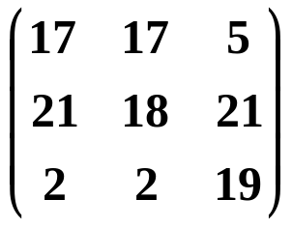
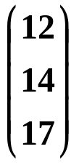
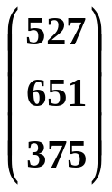
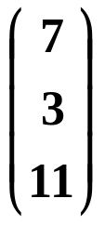
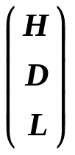
Hill密码的例子
加密：
密钥矩阵K＝
K^{－1}＝
明文分组P＝“mor”
明文编码 P＝
＝
加密 C≡
≡
≡
mod 26
解码 C＝
，即C＝“HDL”

Slide 42
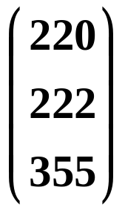
Hill密码的例子
解密：
密钥矩阵K＝
K^{－1}＝
C＝“HDL”
C＝
＝
解密 P≡
≡
≡
mod 26
明文 P＝
＝
明文P＝“mor”

Slide 43
Hill密码的特点
字母的统计规律进一步降低
明、密文字母不是一一对应关系

Slide 44
§2.2.5 多表代替密码
Polyalphabetic Ciphers
特点：在明文消息中采用不同的单表代换。
安全性提高
使得字母的频率分布更加平坦
用一个密钥指示明文消息中每个字母加解密时所用的代替表
密钥依次重复使用，代替表依次重复使用
例子：
  Vigenère（维吉利亚）密码（1858）
  Vernam（唯尔南）密码（1918）
Notes:
One approach to reducing the "spikyness" of natural language text is used the Playfair cipher which encrypts more than one letter at once. We now consider the other alternative, using multiple cipher alphabets in turn. This gives the attacker more work, since many alphabets need to be guessed, and because the frequency distribution is more complex, since the same plaintext letter could be replaced by several ciphertext letters, depending on which alphabet is used. The general name for this approach is a polyalphabetic substitution cipher. All these techniques have the following features in common:
A set of related monoalphabetic substitution rules is used.
2. A key determines which particular rule is chosen for a given transformation.

Slide 45
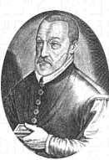
一、 Vigenère（维吉利亚）密码
加密:
方式一：数学公式计算
  设明文 P = p₁p₂…p_{n}，密钥 k = k₁k₂…k_{n}，密文C = c₁c₂…c_{n}
    ① 明文编码；
    ② 计算 c_{i}= p_{i}+k_{i} (mod 26)，=1，2，…，n；
    ③ 密文解码。
  说明：若明文长度大于n，则K重复使用。

Slide 46
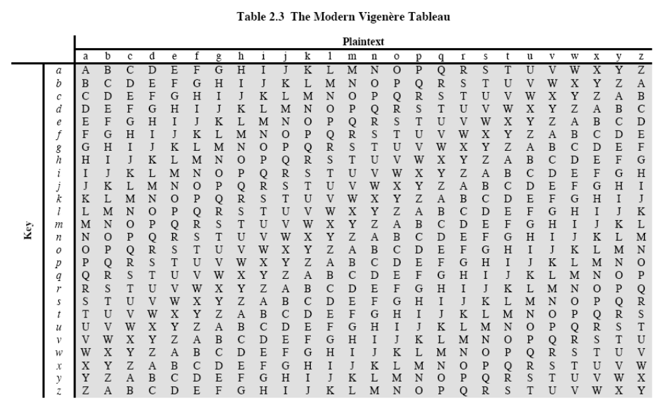
一、 Vigenère（维吉利亚）密码
方式二：查表法

Slide 47
一、 Vigenère（维吉利亚）密码
解密：
方法一：数学公式计算
  p_{i} = c_{i}－k_{i} (mod 26)，=1，2，…，n；
方法二：查表

Slide 48
Vigenère密码例子
加密过程：
  P＝“encode and decode”，k＝“mykey”
字母序号 |  | 1 | 2 | 3 | 4 | 5 | 6 | 7 | 8 | 9 | 10 | 11 | 12 | 13 | 14 | 15
明文编码 | P = | 4 | 13 | 2 | 14 | 3 | 4 | 0 | 13 | 3 | 3 | 4 | 2 | 14 | 3 | 4
密钥编码 | k = | 12 | 24 | 10 | 4 | 24 | 12 | 24 | 10 | 4 | 24 | 12 | 24 | 10 | 4 | 24
加密 | C = | 16 | 37 | 12 | 18 | 27 | 16 | 24 | 23 | 7 | 27 | 16 | 26 | 24 | 7 | 28
模运算 |  |  | 11 |  |  | 1 |  |  |  |  | 1 |  | 0 |  |  | 2
密文解码 | C = | Q | L | M | S | B | Q | Y | X | H | B | Q | A | Y | H | B

Slide 49
Vigenère密码例子
解密过程：
  C＝“QLMSBQYXHBQAYHB”，k＝“mykey”
字母序号 |  | 1 | 2 | 3 | 4 | 5 | 6 | 7 | 8 | 9 | 10 | 11 | 12 | 13 | 14 | 15
密文编码 | C= | 16 | 11 | 12 | 18 | 1 | 16 | 24 | 23 | 7 | 1 | 16 | 0 | 24 | 7 | 2
密钥编码 | k= | 12 | 24 | 10 | 4 | 24 | 12 | 24 | 10 | 4 | 24 | 12 | 24 | 10 | 4 | 24
加密 | C= | 4 | -13 | 2 | 14 | -23 | 4 | 0 | 13 | 3 | -23 | 4 | -24 | 14 | 3 | -22
模运算 |  |  | 13 |  |  | 3 |  |  |  |  | 3 |  | 2 |  |  | 4
密文解码 | C= | e | n | c | o | d | e | a | n | d | d | e | c | o | d | e

Slide 50
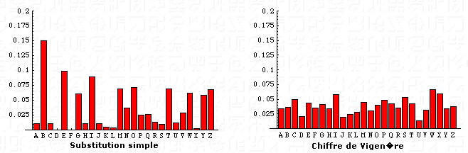
Vigenère密码的安全性
密钥空间：|K|＝26^{n}
字母的统计规律进一步降低
明、密文字母不是一一对应关系
Vigenére本人建议：密钥与明文一样长
特例：
  当k₁ ＝ k₂ ＝ … ＝ k_{n} ＝k时，是Caesar密码
Notes:
The Vigenère & related polyalphabetic ciphers still do not completely obscure the underlying language characteristics.
The key to breaking them was to identify the number of translation alphabets, and then attack each separately.

Slide 51
§2.2.6 一次一密
随机密钥
理论上不可破
实际上不可行
  产生大量的随机密钥难
  密钥分配与保护更难
Notes:
The One-Time Pad is an evolution of the Vernham cipher, which was invented by Gilbert Vernham in 1918, and used a long tape of random letters to encrypt the message. An Army Signal Corp officer, Joseph Mauborgne, proposed an improvement using a random key that was truly as long as the message, with no repetitions, which thus totally obscures the original message. It produces random output that bears no statistical relationship to the plaintext. Because the ciphertext contains no information whatsoever about the plaintext, there is simply no way to break the code, since any plaintext can be mapped to any ciphertext given some key.
The one-time pad offers complete security but, in practice, has two fundamental difficulties:
There is the practical problem of making large quantities of random keys.
2. And the problem of key distribution and protection, where for every message to be sent, a key of equal length is needed by both sender and receiver.
Because of these difficulties, the one-time pad is of limited utility, and is useful primarily for low-bandwidth channels requiring very high security.

Slide 52
§2.3 置换密码
Transposition Ciphers
栅栏技术
思想：以列（行）优先写出明文，以行（列）优先读出各字母作为密文
  例1：先行后列
  例2：先列后行
改 进
带有密钥
再改进：重复加密，多步置换

Slide 53
例：栅栏密码(Rail Fence cipher)
明文：meet me after the toga party
写作:
  m e m a t r h t g p r y
  e t e f e t e o a a t
读出密文为：
  MEMATRHTGPRYETEFETEOAAT
Notes:
The simplest such cipher is the rail fence technique, in which the plaintext is written down as a sequence of diagonals and then read off as a sequence of rows.
The example message is: "meet me after the toga party" with a rail fence of depth 2.
This sort of thing would be trivial to cryptanalyze.

Slide 54
无密钥的置换技术
栅栏技术：按对角线的顺序写出明文，以行的顺序读出作为密文
Example
明文消息 “Meet me at the park”
密文消息 “MEMATEAKETETHPR”

Slide 55
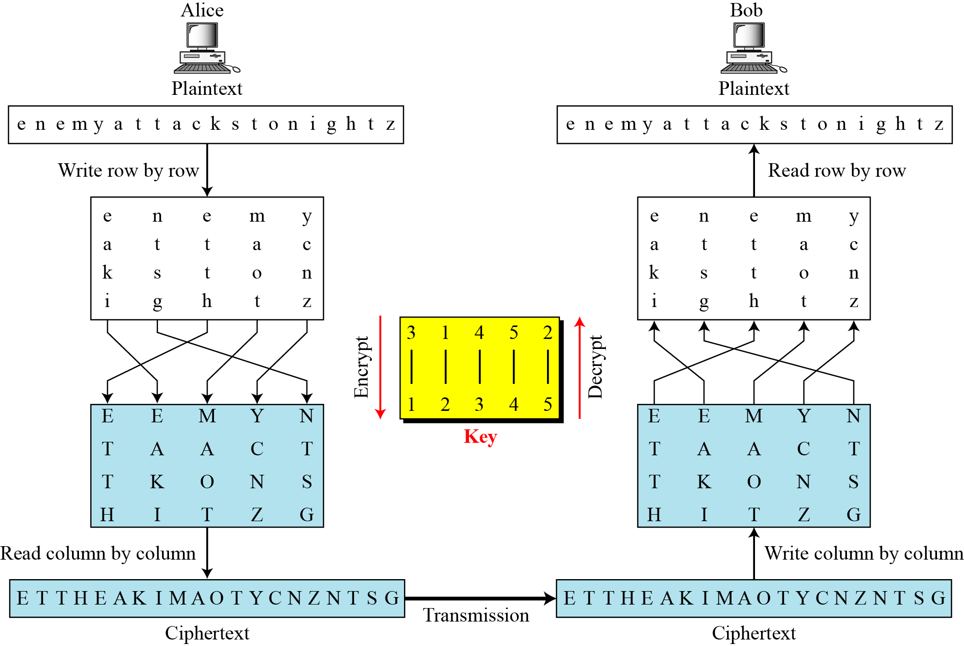
带密钥的置换技术

Slide 56
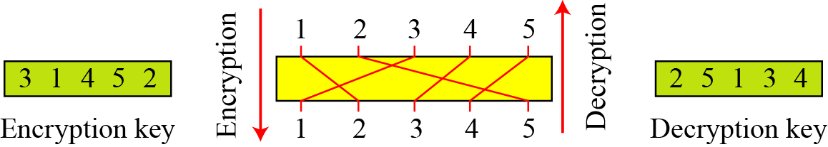
2. 带密钥的置换技术
同一个密钥在加密和解密（列置换）过程中，以不同的方向来使用
在加解密过程中好像使用的是两个不同的密钥
置换操作中的加密密钥和解密密钥

Slide 57
例：行移位密码 Row Transposition Ciphers
更加复杂的移位
以指定的行将明文写作多行
按照密钥指定的列读出
  Key:
  Plaintext:
  Ciphertext: TTNAAPTMTSUOAODWCOIXKNLYPETZ
3 | 4 | 1 | 2 | 5 | 6 | 7
a | t | t | a | c | k | p
o | s | t | p | o | n | e
d | u | n | t | i | l | t
w | o | a | m | x | y | z
Notes:
A more complex transposition cipher is to write the message in a rectangle, row by row, and read the message off shuffling the order of the columns in each row.
A pure transposition cipher is easily recognized because it has the same letter frequencies as the original plaintext. For the type of columnar transposition just shown, cryptanalysis is fairly straightforward and involves laying out the ciphertext in a matrix and playing around with column positions. Digram and trigram frequency tables can be useful.

Slide 58
§2.4 转轮密码
在现代密码之前，转轮密码是最广泛使用的复杂的密码
广泛用在第二次世界大战中
  German Enigma, Allied Hagelin, Japanese Purple
实现了复杂多变的多表代替密码，多层加密
采用一系列转轮，每一个都是一个代替表，转轮可以依次旋转加密每个字母
  用3个转轮就有 26³=17576 代替表
Notes:
The next major advance in ciphers required use of mechanical cipher machines which enabled to use of complex varying substitutions.
A rotor machine consists of a set of independently rotating cylinders through which electrical pulses can flow. Each cylinder has 26 input pins and 26 output pins, with internal wiring that connects each input pin to a unique output pin. If we associate each input and output pin with a letter of the alphabet, then a single cylinder defines a monoalphabetic substitution. After each input key is depressed, the cylinder rotates one position, so that the internal connections are shifted accordingly. The power of the rotor machine is in the use of multiple cylinders, in which the output pins of one cylinder are connected to the input pins of the next, and with the cylinders rotating like an “odometer”, leading to a very large number of substitution alphabets being used, eg with 3 cylinders have 26³=17576 alphabets used.
They were extensively used in world war 2, and the history of their use and analysis is one of the great stories from WW2.

Slide 59
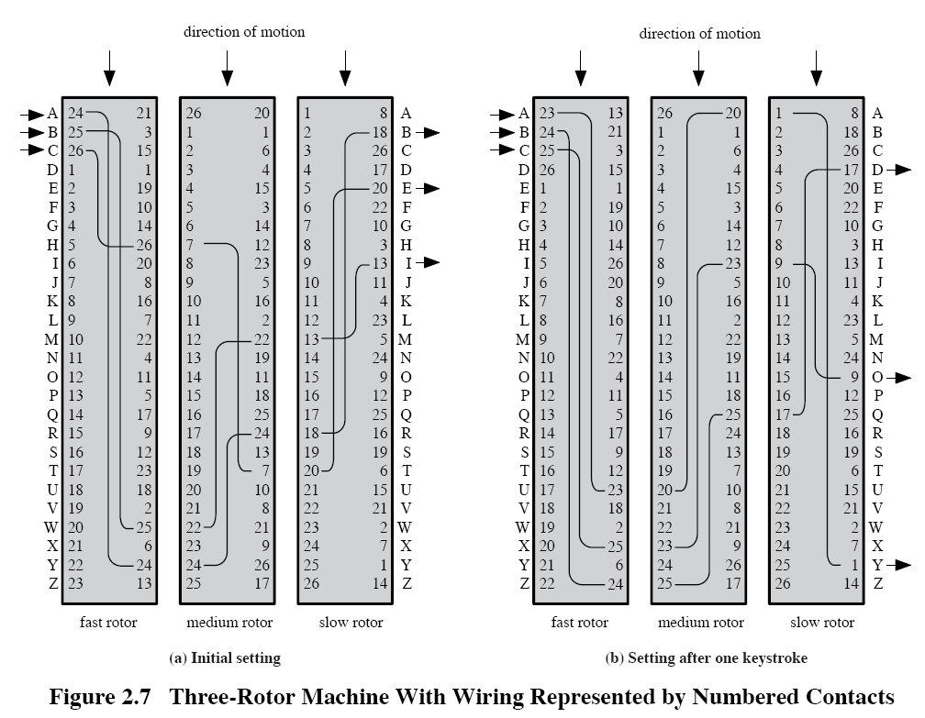

Slide 60
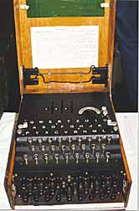
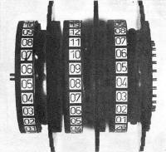
Enigma 密码机(德国)

Slide 61
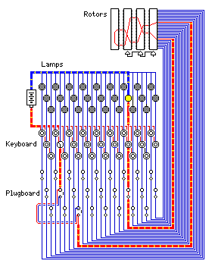
Two diagrams of the Enigma

Slide 62

Hagelin 转轮密码机（盟军 ）
Notes:
This photo of an Allied Hagelin machine was taken by Lawrie Brown at Eurocrypt'93 in Norway. Note pen for scale, and the rotating cipher wheels near the front.

Slide 63
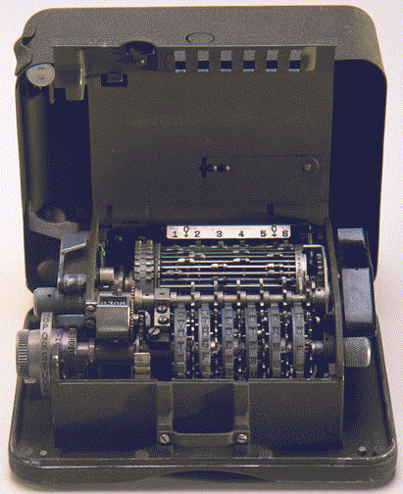
M-209 密码机（美国）

Slide 64
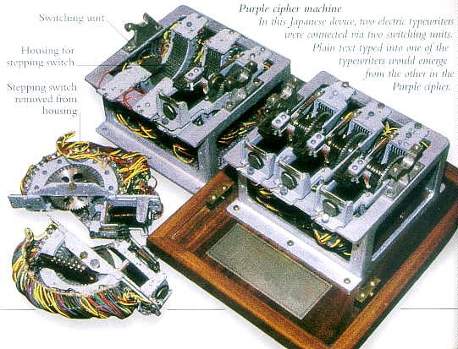
Purple 密码机（日本）

Slide 65
小结
  古典密码技术及术语
  单表代替密码
  用字母频率进行密码分析
  Playfair密码
  多表代替密码
  置换密码
  转轮机密码
Notes:
Chapter 2 summary.

